Slide 1
Learning Objective
I will be able to describe the transformations f(x+c) and f(x) + d
Success Criteria
At the end of the lesson, I will be able to:
apply an understanding of the graphs of functions to generalise and describe the transformations f(x+c) and f(x) + d; and
solve algebraic problems involving horizontal and vertical translations.

Slide 2
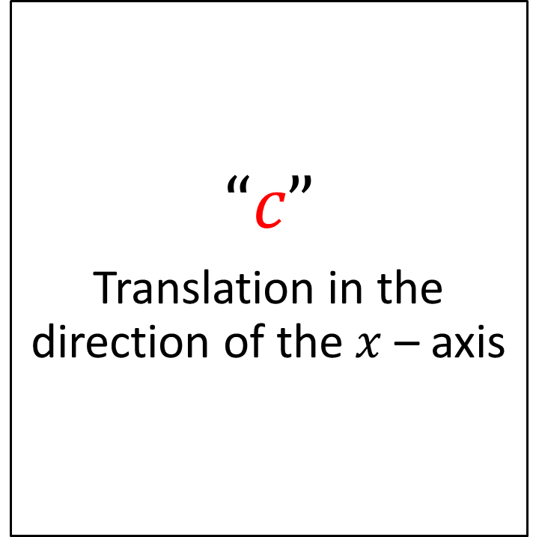
Horizontal Translation
Concept Development
The transformation f(x + c) generalises a horizontal translation, c units.
“If +c, ...in the direction of the negative x-axis” (LEFT)
“If -c, ...in the direction of the positive x-axis” (RIGHT)
$$“c”$$
Translation in the direction of the $x$ – axis

Slide 3
Horizontal Translation
Concept Development
The transformation f(x + c) generalises a horizontal translation, c units.
“If +c, ...in the direction of the negative x-axis” (LEFT)
“If -c, ...in the direction of the positive x-axis” (RIGHT)
$$“c”$$
Translation in the direction of the $x$ – axis

Slide 4


Guided Practice
Describe the transformations that have occured from:
Describe the transformations that have occured from:
The function, f(x) has translated 4 units horizontally to the left
The function, f(x) has translated 2 units horizontally to the right
The function, f(x) has translated 4 units in the negative direction along the x-axis
The function, f(x) has translated 2 units in the positive direction along the x-axis

Slide 5
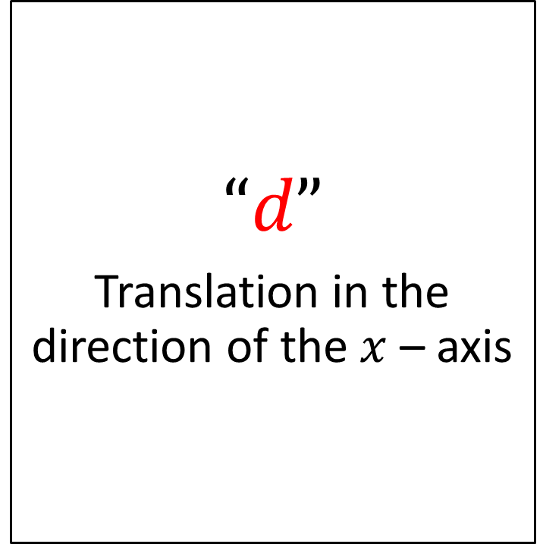
Vertical Translation
Concept Development
The transformation f(x)+d generalises a vertical translation, d units.
“If +d, ...in the direction of the positive y-axis” (UP)
“If -d, ...in the direction of the negative x-axis” (DOWN)
$$“d”$$
Translation in the direction of the $x$ – axis

Slide 6




Guided Practice
Describe the transformations that have occured from:
Describe the transformations that have occured from:
$$f\left(x−1\right)=x^{2}−8$$
The function, f(x) has translated 1 units vertically down
$$f\left(x−1\right)+14=x^{2}+6$$
The function, f(x) has translated 1 unit horizontally to the right and 14 units vertically up.
The function, f(x) has translated 1 units in the negative direction along the y-axis
The function, f(x) has translated 1 unit in the positive direction along the x-axis and 14 units in the positive direction along the y-axis.

Slide 7
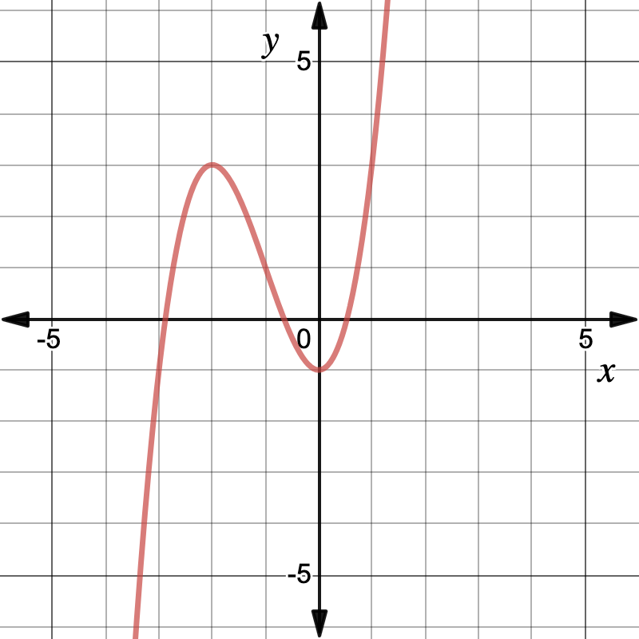
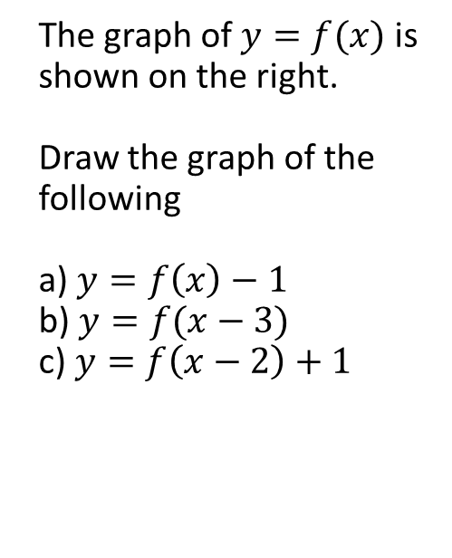
Guided Practice
The graph of $y=f(x)$ is shown on the right.
Draw the graph of the following
a) $y=f\left(x\right)−1$
b) $y=f(x−3)$
c) $y=f\left(x−2\right)+1$

Slide 8
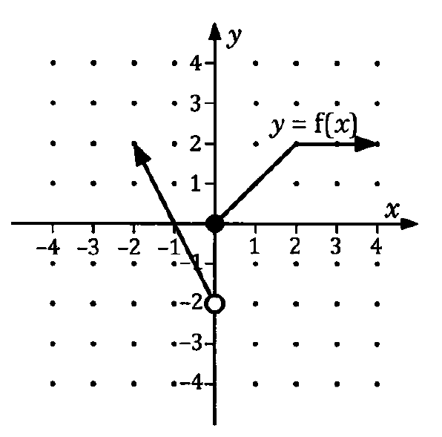
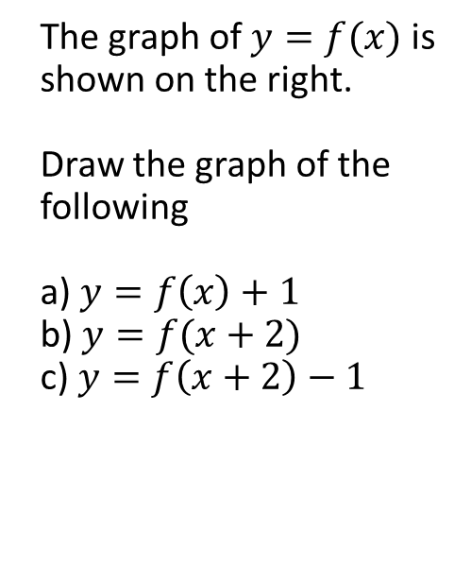
Guided Practice
The graph of $y=f(x)$ is shown on the right.
Draw the graph of the following
a) $y=f\left(x\right)+1$
b) $y=f(x+2)$
c) $y=f\left(x+2\right)−1$

Slide 9

Guided Practice
Find the image of the point (-3, 4) after a mapping of translation:
Of 2 units in the positive direction of the x-axis and 3 units in the negative direction of the y-axis
Defined by the rule $\left(x,y\right)→(x−4,y+5)$
a) $\left(−3,4\right)→\left(−3+2,4−3\right)=(−1,1)$
b) $\left(−3,4\right)→\left(−3−4,4+5\right)=(−7,9)$

Slide 10

Guided Practice
Find the rule for the image of the graph $y=f(x)$ under the following transformation
$f\left(x\right)=\frac{1}{x}$ under translation 2 units in the positive direction of the $x−$ axis and 1 unit in the negative direction of the $y−$ axis

Slide 11

Guided Practice
Find the rule for the image of the graph $y=f(x)$ under the following transformation
$f\left(x\right)=x^{2}$ under translation 2 units in the negative direction of the $x−$ axis and 3 unit in the negative direction of the $y−$ axis

Slide 12

Guided Practice
Find the rule for the image of the graph $y=f(x)$ under the following transformation
$f\left(x\right)=\sqrt{x}$ under translation 2 units in the positive direction of the $x−$ axis and 1 unit in the negative direction of the $y−$ axis

Slide 13

Guided Practice
For $y=f\left(x\right)=\frac{1}{x}$ , sketch the graph of the following, labelling key features of the graph
$f(x−1)$

Slide 14

Guided Practice
For $y=f\left(x\right)=\frac{1}{x}$ , sketch the graph of the following, labelling key features of the graph
$f\left(x\right)−3$

Slide 15

Guided Practice
For $y=f\left(x\right)=\frac{1}{x}$ , sketch the graph of the following, labelling key features of the graph
$f\left(x+1\right)−3$

Slide 16

Guided Practice
For $y=f\left(x\right)=x^{2}$ , sketch the graph of the following, labelling key features of the graph
$f\left(x+3\right)$

Slide 17

Guided Practice
For $y=f\left(x\right)=x^{2}$ , sketch the graph of the following, labelling key features of the graph
$f\left(x\right)−1$

Slide 18

Guided Practice
For $y=f\left(x\right)=x^{2}$ , sketch the graph of the following, labelling key features of the graph
$f\left(x−3\right)+1$

Slide 19
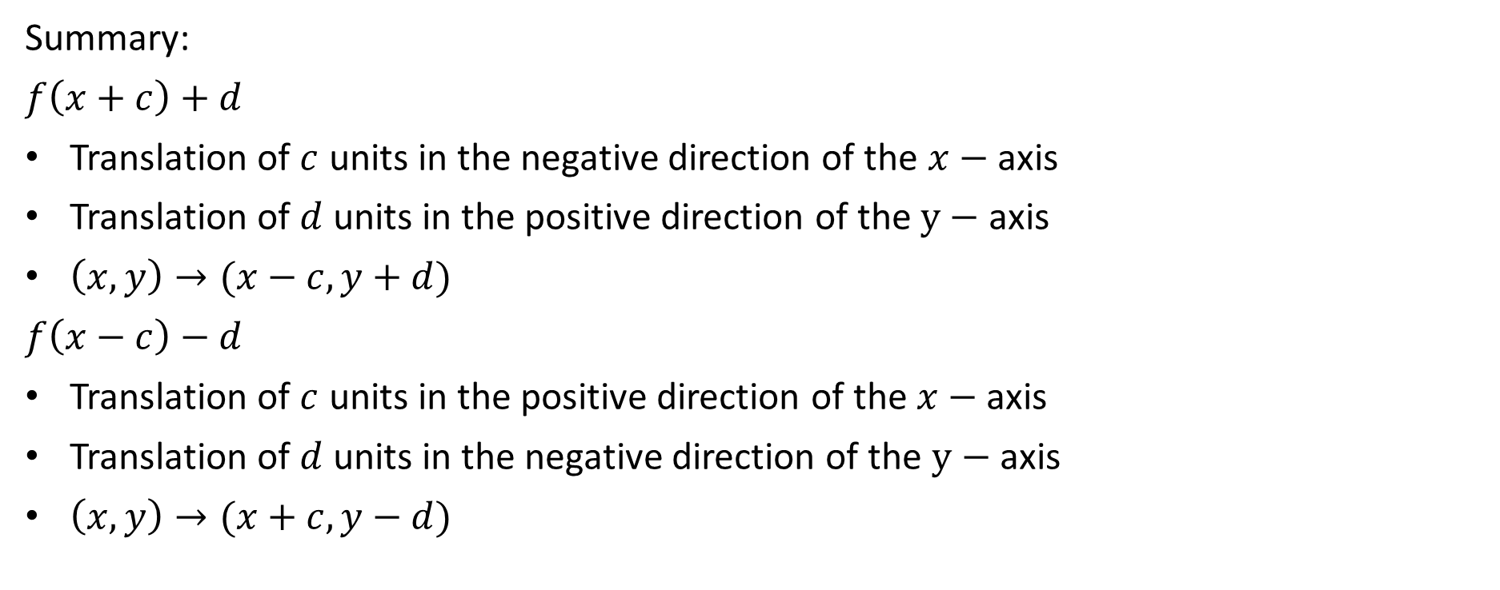
Independent Practice
Complete Ex 6F
Summary:
$f\left(x+c\right)+d$
Translation of $c$ units in the negative direction of the $x−$ axis
Translation of $d$ units in the positive direction of the $y−$ axis
$\left(x,y\right)→(x−c,y+d)$
$f\left(x−c\right)−d$
Translation of $c$ units in the positive direction of the $x−$ axis
Translation of $d$ units in the negative direction of the $y−$ axis
$\left(x,y\right)→(x+c,y−d)$

